Slide 1
Getting started on the PACE cluster
GEORGIA TECH CORE Lab

Slide 2
Georgia Tech's research computing clusters
Phoenix
ICE
Firebird
Buzzard
The main research cluster, open campus-wide. Jobs are charged to your PI's account
The instructional cluster. Access comes with enrollment in a course that uses it
For projects with controlled data that must meet CUI or ITAR requirements
A high-throughput cluster connected to the Open Science Grid

Slide 3

PACE Phoenix workflow
Compute nodes
Your laptop
Login nodes
Slurm
SSH / web browser
Edit files, submit jobs
Queues jobs, assigns nodes
CPUs / GPUs
Shared storage
home, project, scratch, the same files from every node
Not log in to a compute node directly
Describe the job
Slurm finds the hardware

Slide 4
Logging in with SSH
1
Dr. Hale requests Phoenix access for you
2
Connect to the GT VPN when you're off campus
3
SSH in with your GT username and password via PowerShell / Terminal
ssh xxxxxx@login-phoenix.pace.gatech.edu
ssh hrao43@login-phoenix.pace.gatech.edu

Slide 5
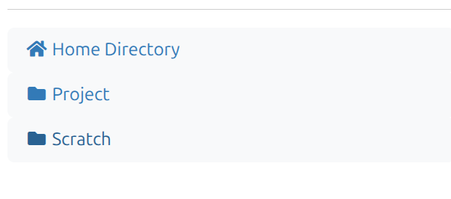
File transfer
Where you store your scripts, important data, etc.
Once log in, you will see
Not important data such as temporary files. Will be automatically deleted by system after 60 days
In browser file transfer (best for small files): https://ondemand-phoenix.pace.gatech.edu/pun/sys/dashboard
Globus (for large files): https://www.globus.org/
scp/rsync command
scp -r data/ xxx@login-phoenix.pace.gatech.edu:~/scratch/data/

Slide 6
Loading software with modules
Nothing is on your PATH by default
module avail
# what's installed
Compilers, Python, MATLAB and more are loaded on demand.
module spider python
# search
module load anaconda3
# use it
Put module loads in your job script
module list
# what's loaded
So every run starts from the same environment.

Slide 7
First job script: demo_cpu.sbatch
-J
Job name
#!/bin/bash
#SBATCH -J hello-pace
-A
Charge account (run pace-quota in terminal)
#SBATCH -A gts-mhale30
#SBATCH -q inferno
-q
QOS: inferno (normal priority queue)
#SBATCH -N 1 --ntasks-per-node=4
#SBATCH --mem-per-cpu=4G
#SBATCH --partition=cpu-gnr
-N, ntasks
1 node, 4 cores
#SBATCH --constraint=graniterapids
#SBATCH -t 01:00:00
--mem…
Memory per core
#SBATCH -o %x-%j.out
-t
Wall time; the job is killed after it
cd $SLURM_SUBMIT_DIR
module load anaconda3
-o
Output file: job name + job ID
python hello.py

Slide 8
(Optional) Interactive jobs for testing and debugging
# ask for 4 cores for one hour; you get a shell when it starts
salloc -A gts-mhale30 -q inferno -N1 --ntasks-per-node=4 -t 1:00:00
# you're now on a compute node; type exit when done
exit
Use it to
Don't
Try commands, debug a crash
Leave it idle. The clock and the charges run until you exit.

Slide 9
Second job script: demo_gpu.sbatch
#!/bin/bash
module load anaconda3
conda activate torch-env
LRS=(0.0001 0.0003 0.001 0.003 0.01 0.03 0.1 0.3 0.5 1.0)
LR=${LRS[$SLURM_ARRAY_TASK_ID-1]}
python train.py $LR $SLURM_ARRAY_TASK_ID
#SBATCH -J demo-gpu
#SBATCH -A gts-mhale30
#SBATCH -q inferno
#SBATCH -N 1 --ntasks-per-node=4
#SBATCH --mem-per-cpu=4G
#SBATCH --partition=gpu-rtx6000
#SBATCH --gres=gpu:1
#SBATCH -t 01:00:00
#SBATCH --array=1-10
#SBATCH -o logs/%x-%A_%a.out

Slide 10
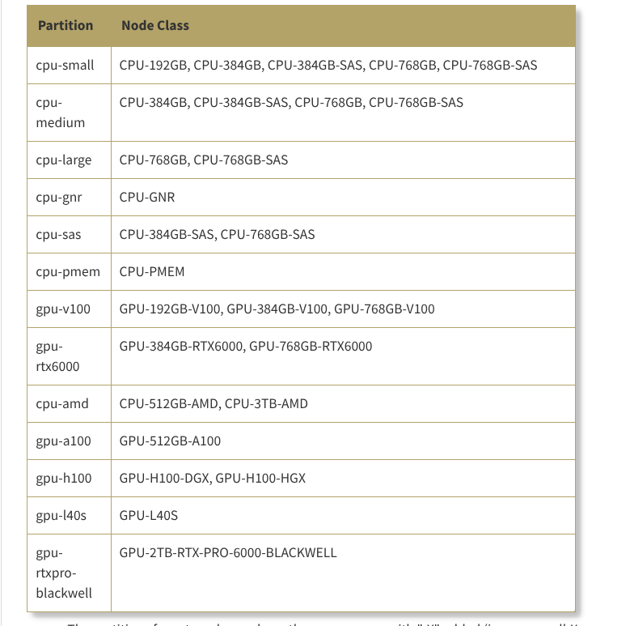
CPU / GPU resources
cpu-gnr
gpu-rtx6000
https://gatech.service-now.com/home?id=kb_article_view&sysparm_article=KB0041976

Slide 11
Watching and managing your jobs
RUNNING JOBS
Command | What it tells you
squeue -u $USER | Your jobs that are waiting or running
scancel <job_id> | Cancels a job
sacct -j <job_id> | How a finished job ended: state, time, memory
pace-check-queue inferno | How busy the cluster is right now
pace-whoami | Your charge accounts and limits
pace-quota | Storage usage and account balances
pace-job-summary <jobid> | A full report on one job, handy for support tickets

Slide 12
Interactive Demo in browser
https://ondemand-phoenix.pace.gatech.edu/pun/sys/dashboard/batch_connect/sessions

Slide 13



Where to go when you're stuck
Documentation
Email support
Talk to a person
Slurm guides, storage, software and examples for each cluster.
Include the cluster, job ID and script path.
PACE runs consulting sessions and orientation trainings.
docs.pace.gatech.edu
pace-support@oit.gatech.edu
pace.gatech.edu
This option works for me in most cases

Slide 14
Thank you!

